Slide 1
The Beast of Bias Data Screening
Chapter 5

Slide 2
Bias
Datasets can be biased in many ways – but here are the important ones:
Bias in parameter estimates (M)
Bias in SE, CI
Bias in test statistic

Slide 3
Data Screening
So, I’ve got all this data…what now?
Please note this is going to deviate from the book a bit and is based on Tabachnick & Fidell’s data screening chapter
Which is fantastic but terribly technical and can cure insomnia.

Slide 4
Why?
Data screening – important to check for errors, outliers, and assumptions.
What’s the most important?
Always check for errors, outliers, missing data.
For assumptions, it depends on the type of test because they have different assumptions.

Slide 5
The List – In Order
Accuracy
Missing Data
Outliers
It Depends (we’ll come back to these):
Correlations/Multicollinearity
Normality
Linearity
Homogeneity
Homoscedasticity

Slide 6
The List – In Order
Why this order?
Because if you fix something (accuracy)
Or replace missing data
Or take out outliers
ALL THE REST OF THE ANALYSES CHANGE.

Slide 7
Accuracy
Check for typos
Frequencies – you can see if there are numbers that shouldn’t be in your data set
Check:
Min
Max
Means
SD
Missing values

Slide 8
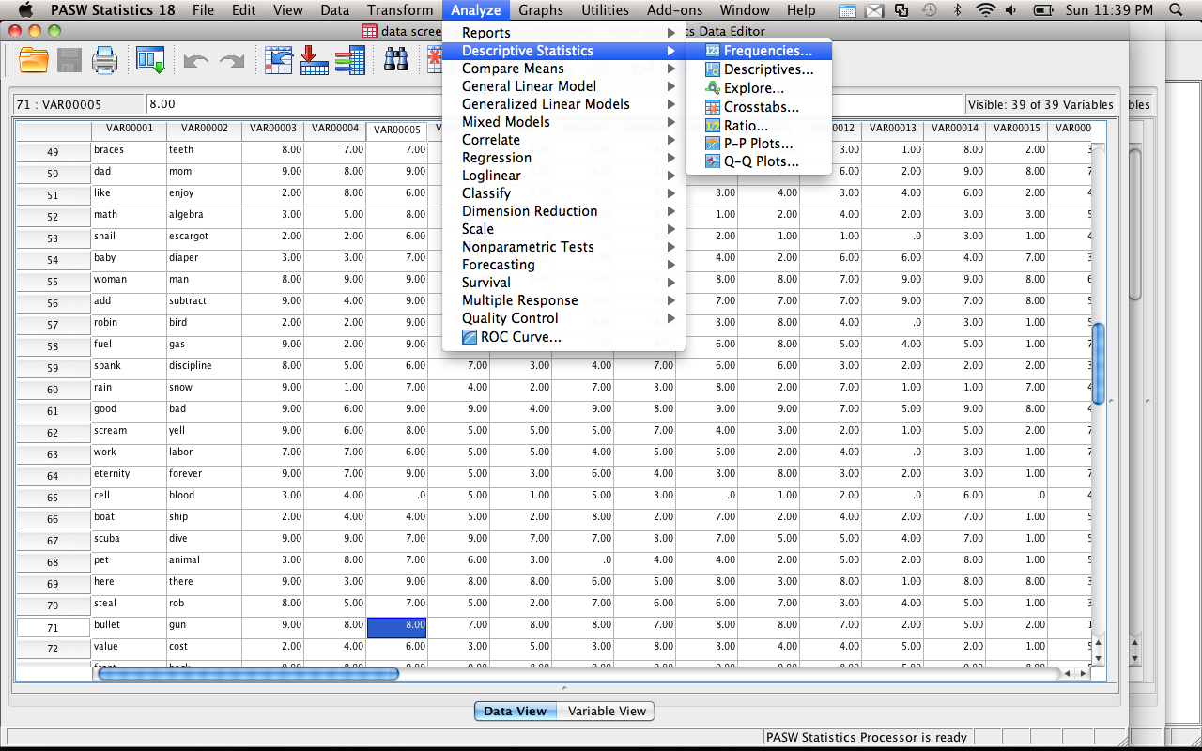
Accuracy

Slide 9
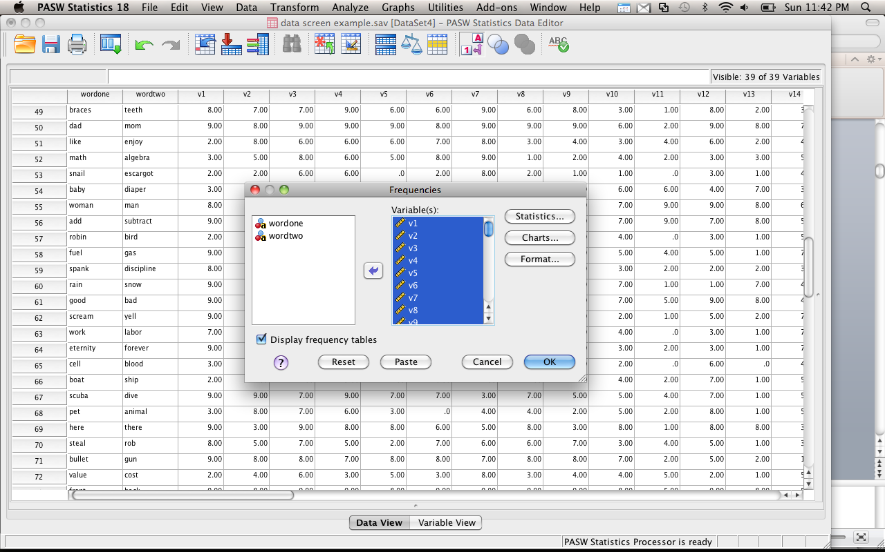

Slide 10
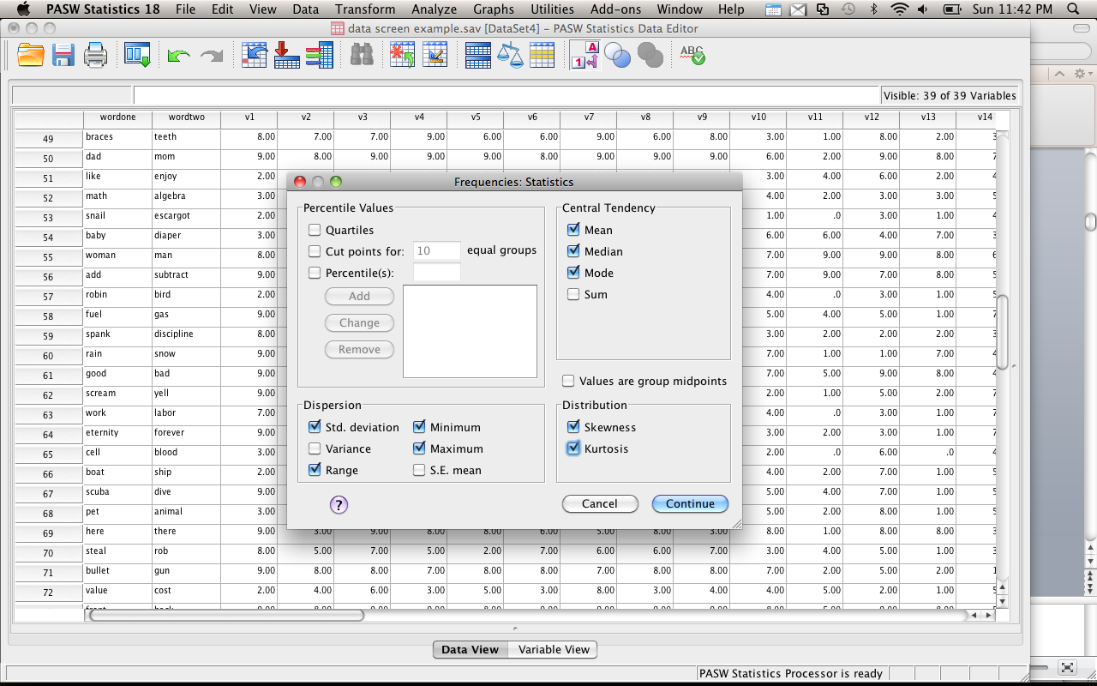

Slide 11
Accuracy
Interpret the output:
Check for high and low values in minimum and maximum
(You can also see the missing data).
Are the standard deviations really high?
Are the means strange looking?
This output will also give you a zillion charts – great for examining Likert scale data to see if you have all ceiling or floor effects.

Slide 12
Missing Data
With the output you already have you can see if you have missing data in the variables.
Go to the main box that is first shown in the data.
See the line that says missing?
Check it out!

Slide 13
Missing Data
Missing data is an important problem.
First, ask yourself, “why is this data missing?”
Because you forgot to enter it?
Because there’s a typo?
Because people skipped one question? Or the whole end of the scale?

Slide 14
Missing Data
Two Types of Missing Data:
MCAR – missing completely at random (you want this)
MNAR – missing not at random (eek!)
There are ways to test for the type, but usually you can see it
Randomly missing data appears all across your dataset.
If everyone missed question 7 – that’s not random.

Slide 15
Missing Data
MCAR – probably caused by skipping a question or missing a trial.
MNAR – may be the question that’s causing a problem.
For instance, what if you surveyed campus about alcohol abuse? What does it mean if everyone skips the same question?

Slide 16
Missing Data
How much can I have?
Depends on your sample size – in large datasets <5% is ok.
Small samples = you may need to collect more data.
Please note: there is a difference between “missing data” and “did not finish the experiment”.

Slide 17
Missing Data
How do I check if it’s going to be a big deal?
Frequencies – you can see which variables have the missing data.
Sample test – you can code people into two groups. Test the people with missing data against those who don’t have missing data.
Regular analysis – you can also try dropping the people with missing data and see if you get the same results as your regular analysis with the missing data.

Slide 18
Missing Data
Deleting people / variables
You can exclude people “pairwise” or “listwise”
Pairwise – only excludes people when they have missing values for that analysis
Listwise – excludes them for all analyses
Variables – if it’s just an extraneous variable (like GPA) you can just delete the variable

Slide 19
Missing Data
What if you don’t want to delete people (using special people or can’t get others)?
Several estimation methods to “fill in” missing data

Slide 20
Missing Data
Prior knowledge – if there is an obvious value for missing data
Such as the median income when people don’t list it
You have been working in the field for a while
Small number of missing cases

Slide 21
Missing Data
Mean substitution – fairly popular way to enter missing data
Conservative – doesn’t change the mean values used to find significant differences
Does change the variance, which may cause significance tests to change with a lot of missing data
SPSS will do this substitution with the grand mean

Slide 22
Missing Data
Regression – uses the data given and estimates the missing values
This analysis is becoming more popular since a computer will do it for you.
More theoretically driven than mean substitution
Reduces variance

Slide 23
Missing Data
Expected maximization – now considered the best at replacing missing data
Creates an expected values set for each missing point
Using matrix algebra, the program estimates the probably of each value and picks the highest one

Slide 24
Missing Data
Multiple Imputation – for dichotomous variables, uses log regression similar to regular regression to predict which category a case should go into

Slide 25
Missing Data
DO NOT mean replace categorical variables
You can’t be 1.5 gender.
So, either leave them out OR pairwise eliminate them (aka eliminate only for the analysis they are used in).
Continuous variables – mean replace, linear trend, etc.
Or leave them out.

Slide 26
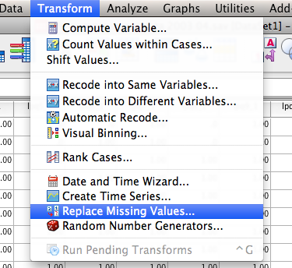

Slide 27
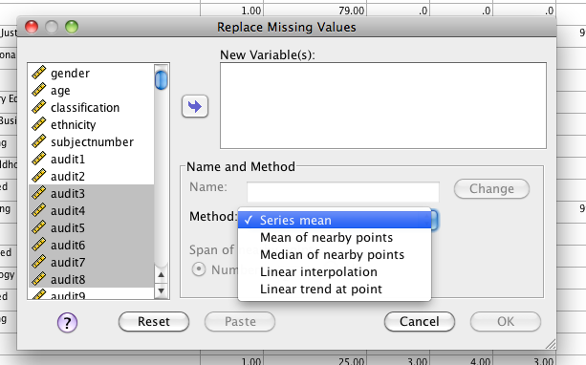

Slide 28
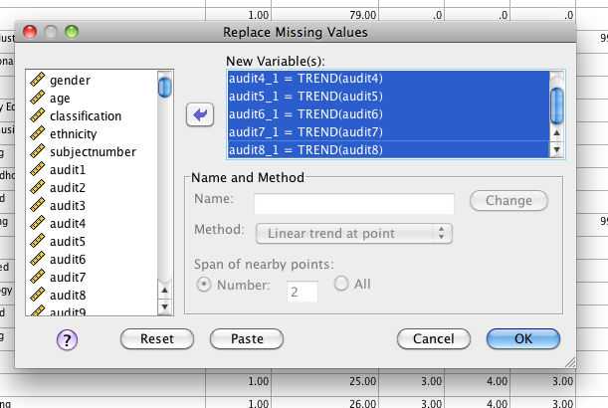

Slide 29
Outliers can Bias a Parameter Estimate

Slide 30
…and the Error associated with that Estimate

Slide 31
Outliers
Outlier – case with extreme value on one variable or multiple variables
Why?
Data input error
Missing values as “9999”
Not a population you meant to sample
From the population but has really long tails and very extreme values

Slide 32
Outliers
Outliers – Two Types
Univariate – for basic univariate statistics
Use these when you have ONE DV or Y variable.
Multivariate – for some univariate statistics and all multivariate statistics
Use these when you have multiple continuous variables or lots of DVs.

Slide 33
Outliers
Univariate
In a normal z-distribution anyone who has a z-score of +/- 3 is less than 2% of the population.
Therefore, we want to eliminate people who’s scores are SO far away from the mean that they are very strange.

Slide 34
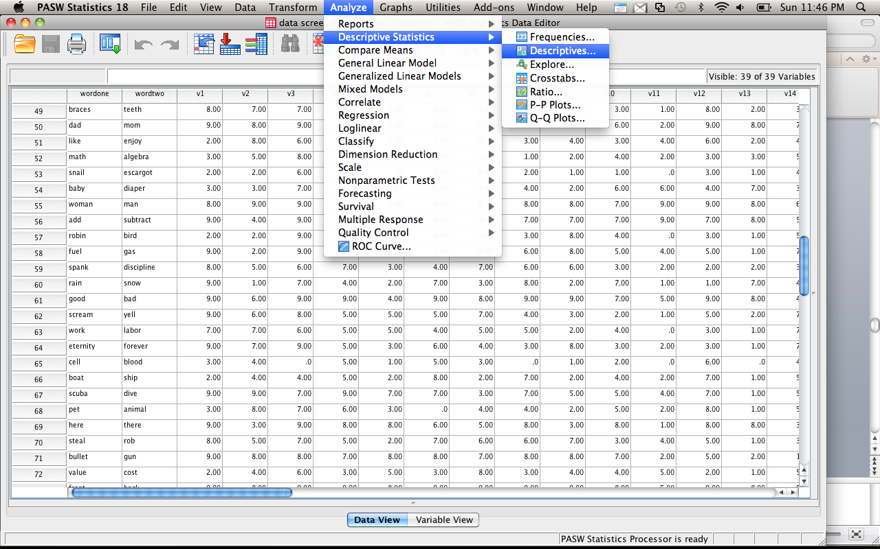
Outliers
Univariate

Slide 35
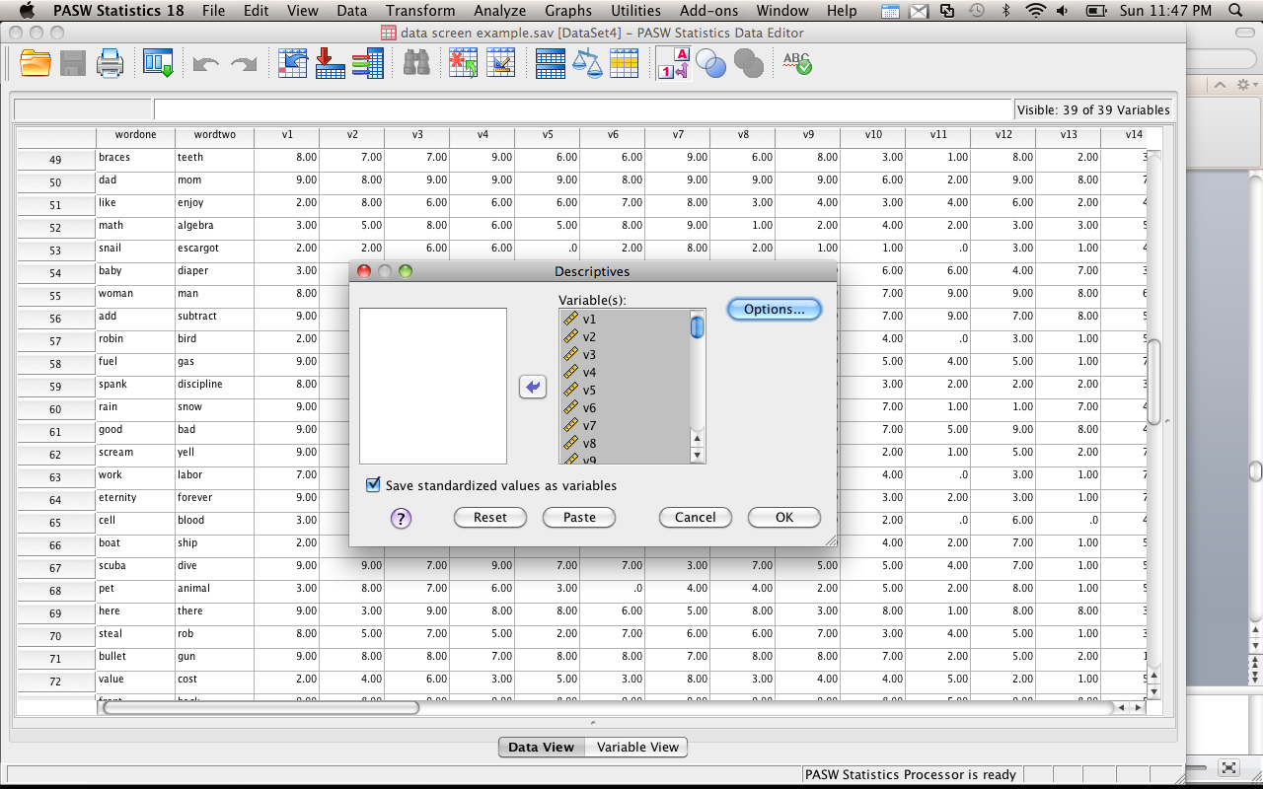

Slide 36
Outliers
Univariate
Now you can scroll through and find all the |3| scores
OR
Rerun your frequency analysis on the Z-scored data.
Now you can see which variables have a min/max of |3|, which will tell you which ones to look at.

Slide 37
Spotting outliers With Graphs

Slide 39
Outliers
Multivariate
Now we need some way to measure distance from the mean (because Z-scores are the distance from the mean), but the mean of means (or all the means at once!)
Mahalanobis distance
Creates a distance from the centroid (mean of means)

Slide 40
Outliers
Multivariate
Centroid is created by plotting the 3D picture of the means of all the means and measuring the distance
Similar to Euclidean distance
No set cut off rule ☹
Use a chi-square table.
DF = # of variables (DVs, variables that you used to calculate Mahalanobis)
Use p<.001

Slide 41
Outliers
The following steps will actually give you many of the “it depends” output.
You will only check them AFTER you decide what to do about outliers.
So you may have to run this twice.
Don’t delete outliers twice!

Slide 42
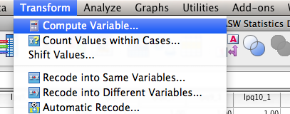

Slide 43
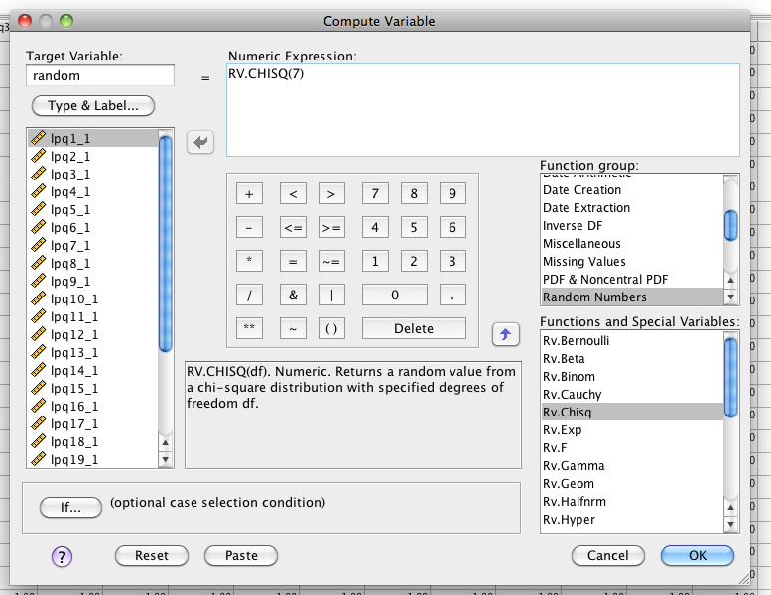

Slide 44
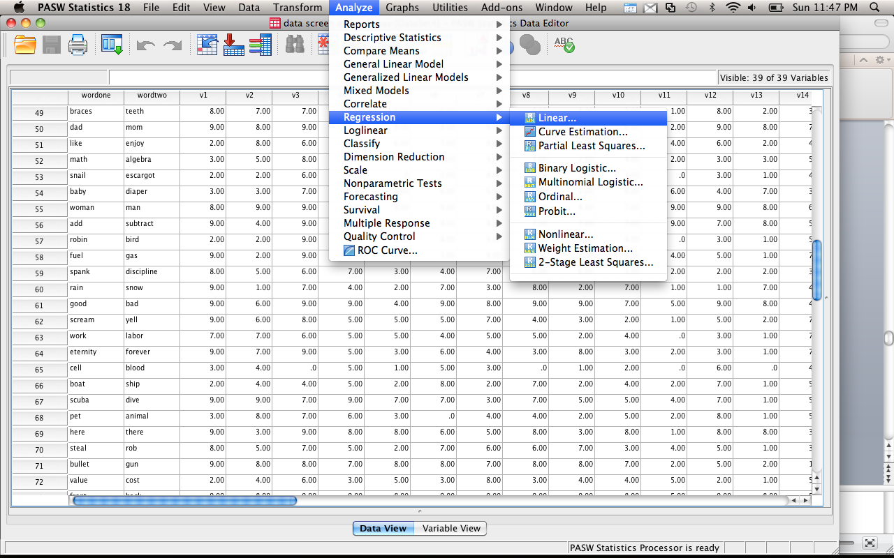

Slide 45
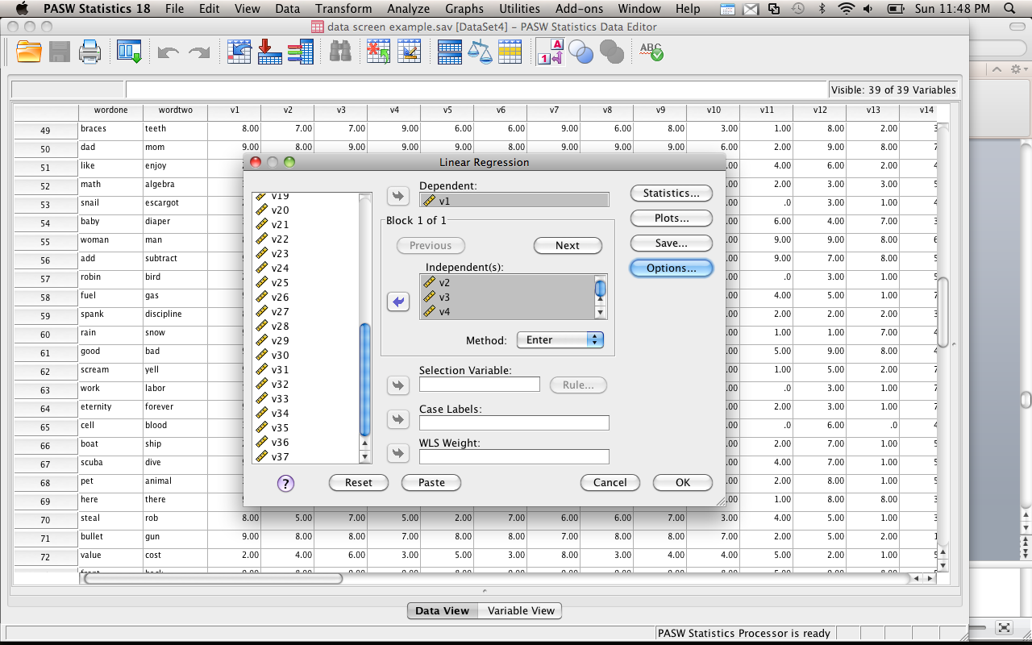

Slide 46
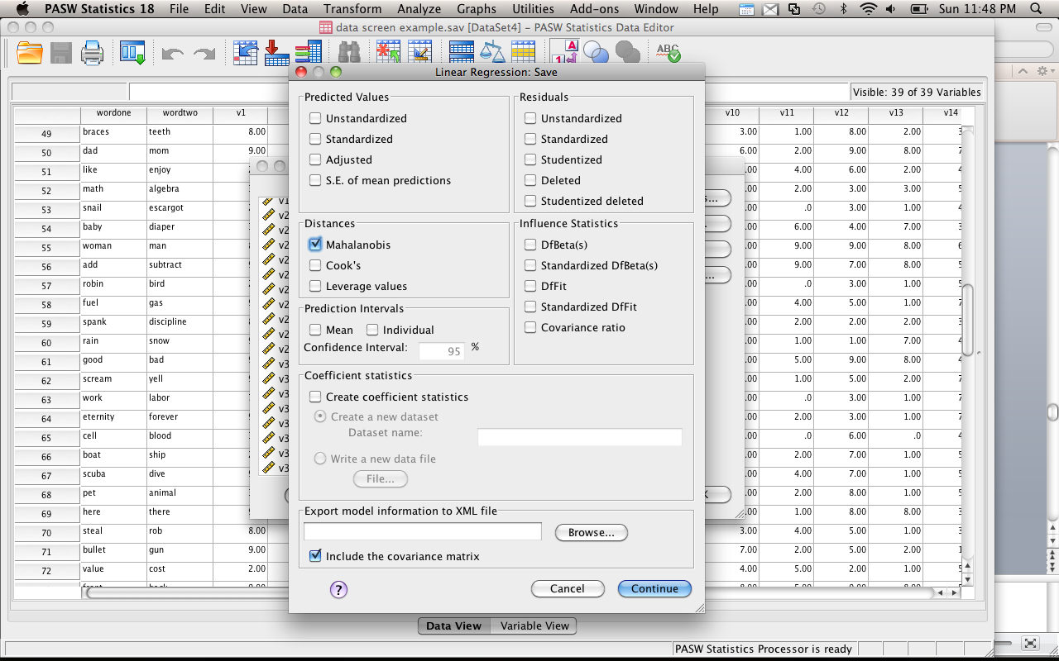

Slide 47
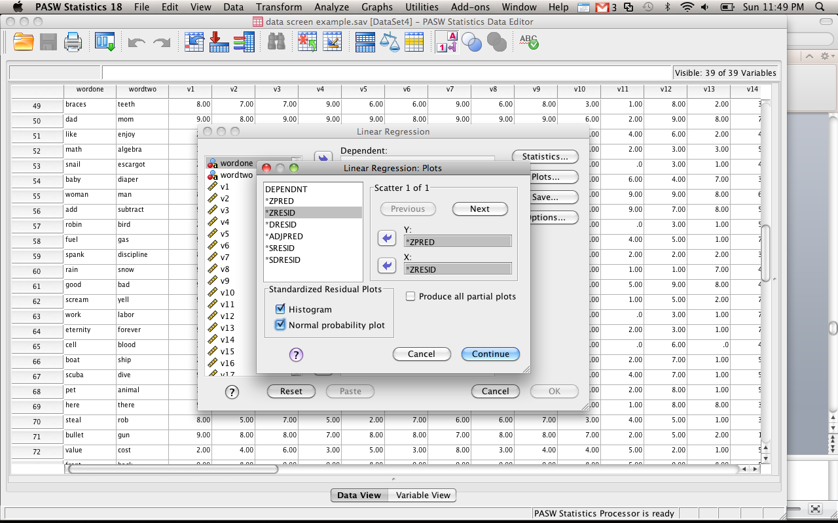

Slide 48
Outliers
Go to the Mahalanobis variable (last new variable on the right)
Right click on the column
Sort DESCENDING
Look for scores that are past your cut off score

Slide 49
Outliers
So do I delete them?
Yes: they are far away from the middle!
No: they may not affect your analysis!
It depends: I need the sample size!
SO?!
Try it with and without them. See what happens. FISH!

Slide 50
Reducing Bias
Trim the data:
Delete a certain amount of scores from the extremes.
Windsorizing:
Substitute outliers with the highest value that isn’t an outlier
Analyse with Robust Methods:
Bootstrapping
Transform the data:
By applying a mathematical function to scores.

Slide 51
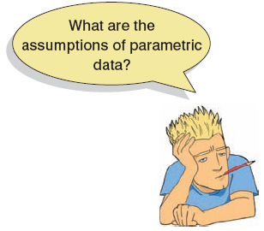
Assumptions
Parametric tests based on the normal distribution assume:
Additivity and linearity
Normality something or other
Homogeneity of Variance
Independence

Slide 52
Additivity and Linearity
The outcome variable is, in reality, linearly related to any predictors.
If you have several predictors then their combined effect is best described by adding their effects together.
If this assumption is not met then your model is invalid.

Slide 53
Additivity
One problem with additivity = multicolllinearity/singularlity
The idea that variables are too correlated to be used together, as they do not both add something to the model.

Slide 54
Correlation
This analysis will only be necessary if you have multiple continuous variables
Regression, multivariate statistics, repeated measures, etc.
You want to make sure that your variables aren’t so correlated the math explodes.

Slide 55
Correlation
Multicollinearity = r > .90
Singularity = r > .95
SPSS will give you a “matrix is singular” error when you have variables that are too highly correlated
Or “hessian matrix not definite”

Slide 56
Correlation
Run a bivariate correlation on all the variables
Look at the scores, see if they are too high
If so:
Combine them (average, total)
Use one of them
Basically, you do not want to use the same variable twice → reduces power and interpretability

Slide 57
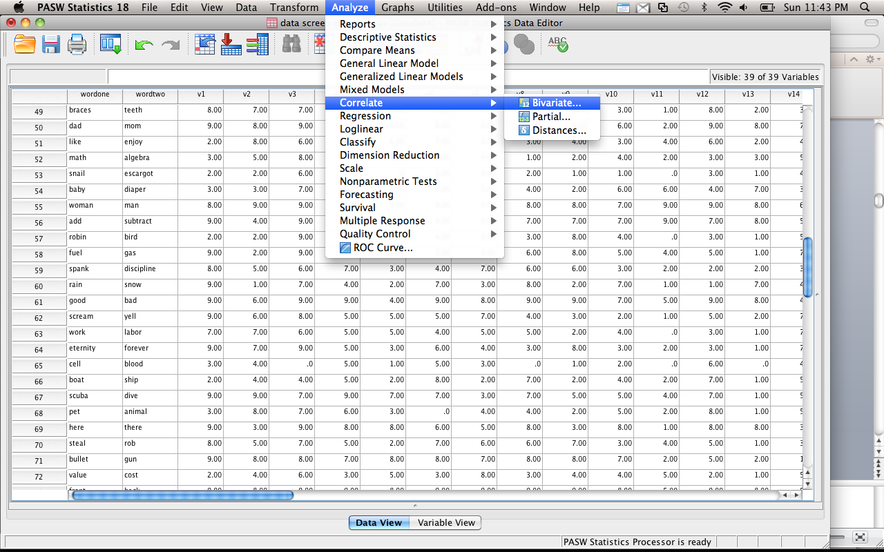

Slide 58
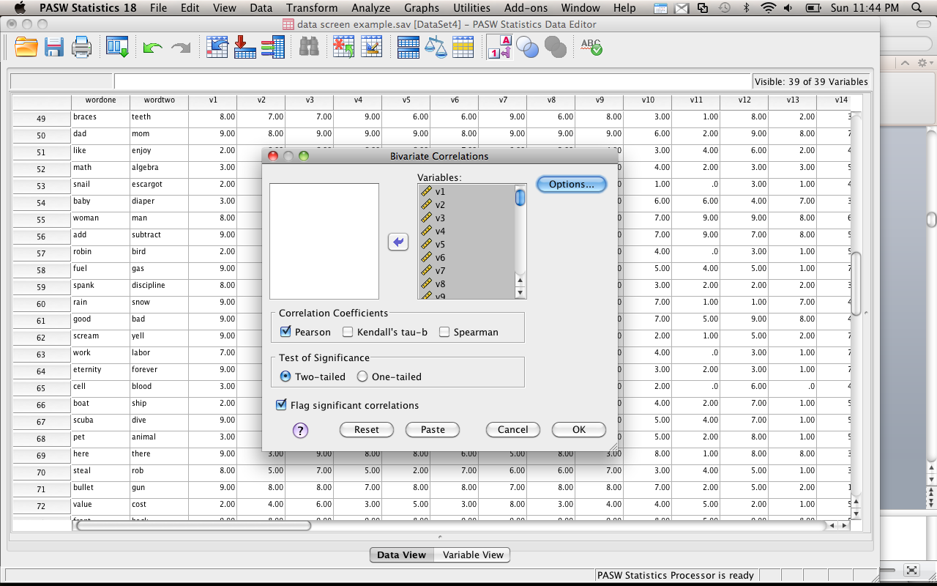

Slide 59
Linearity
Assumption that the relationship between variables is linear (and not curved).
Most parametric statistics have this assumption (ANOVAs, Regression, etc.).

Slide 60
Linearity
Univariate
You can create bivariate scatter plots and make sure you don’t see curved lines or rainbows.
Matrix scatterplots to the rescue!

Slide 61
Linearity
Multivariate – all the combinations of the variables are linear (especially important for multiple regression and MANOVA)
Use the output from your fake regression for Mahalanobis.

Slide 62
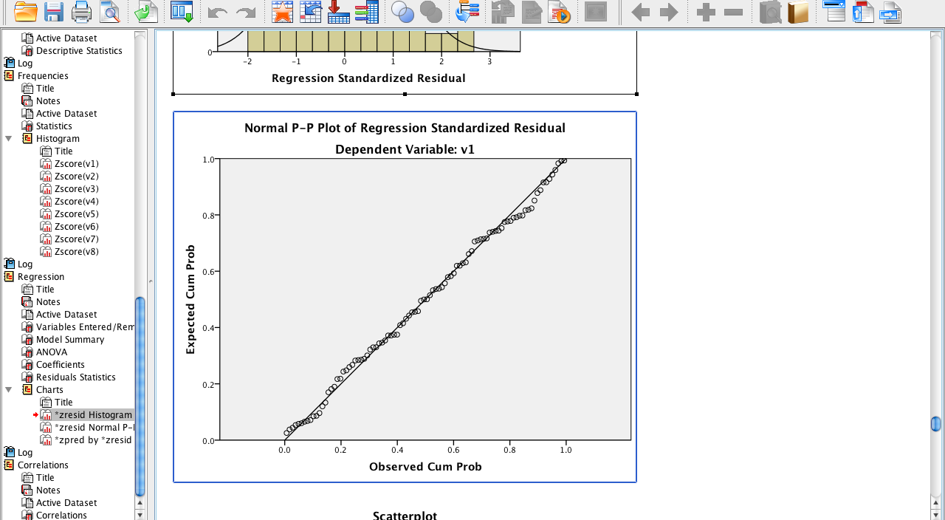

Slide 63
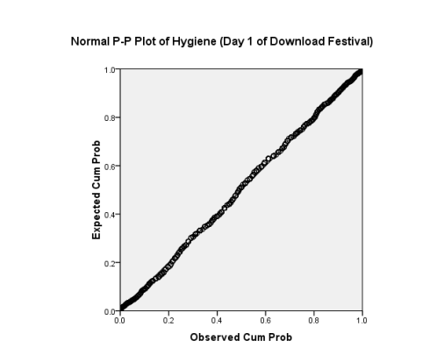
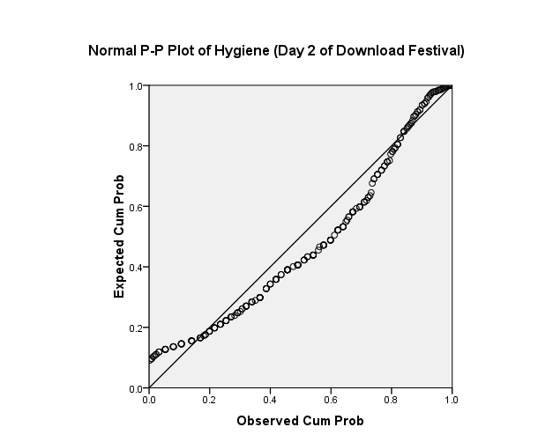
The P-P Plot
Normal
Not Normal

Slide 64
Normally Distributed Something or Other
The normal distribution is relevant to:
Parameters
Confidence intervals around a parameter
Null hypothesis significance testing
This assumption tends to get incorrectly translated as ‘your data need to be normally distributed’.

Slide 65
Normally Distributed Something or Other
Parameters – we assume the sampling distribution is normal, so if our sample is not … then our estimates (and their errors) of the parameters is not correct.
CIs – same problem – since they are based on our sample.
NHST – if the sampling distribution is not normal, then our test will be biased.

Slide 66
When does the Assumption of Normality Matter?
In small samples.
The central limit theorem allows us to forget about this assumption in larger samples.
In practical terms, as long as your sample is fairly large, outliers are a much more pressing concern than normality.

Slide 67
Normality
See page 171 for a fantastic graph about why large samples are awesome
Remember the magic number is N = 30

Slide 68
Normality
Nonparametric statistics (chi-square, log regression) do NOT require this assumption, so you don’t have to check.

Slide 69
Spotting Normality
We don’t have access to the sampling distribution so we usually test the observed data
Central Limit Theorem
If N > 30, the sampling distribution is normal anyway
Graphical displays
P-P Plot (or Q-Q plot)
Histogram
Values of Skew/Kurtosis
0 in a normal distribution
Convert to z (by dividing value by SE)**
Kolmogorov-Smirnov Test
Tests if data differ from a normal distribution
Significant = non-Normal data
Non-Significant = Normal data

Slide 70
Spotting Normality with Numbers: Skew and Kurtosis

Slide 71
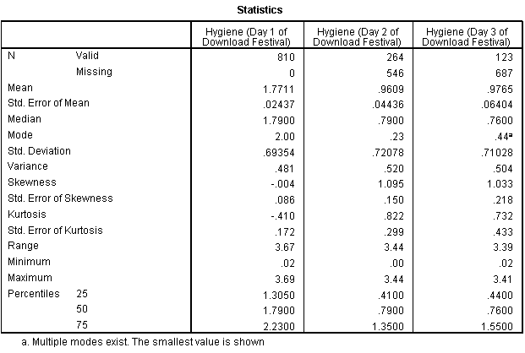
Assessing Skew and Kurtosis

Slide 72
Assessing Normality

Slide 73
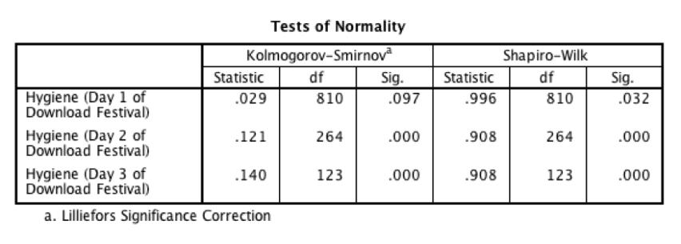
Tests of Normality

Slide 74
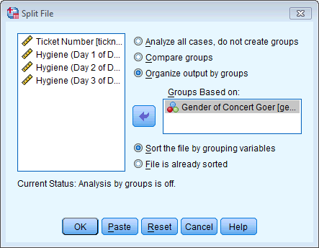
Normality within Groups
The Split File command

Slide 75
Normality Within Groups

Slide 76
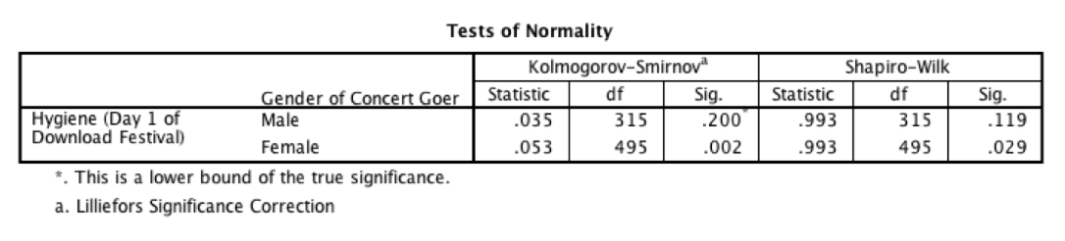
Normality within Groups

Slide 77
Normality
Multivariate – all the linear combinations of the variables need to be normal
Use this version when you have more than one variable
Basically if you ran the Mahalanobis analysis – you want to analyze multivariate normality.

Slide 78
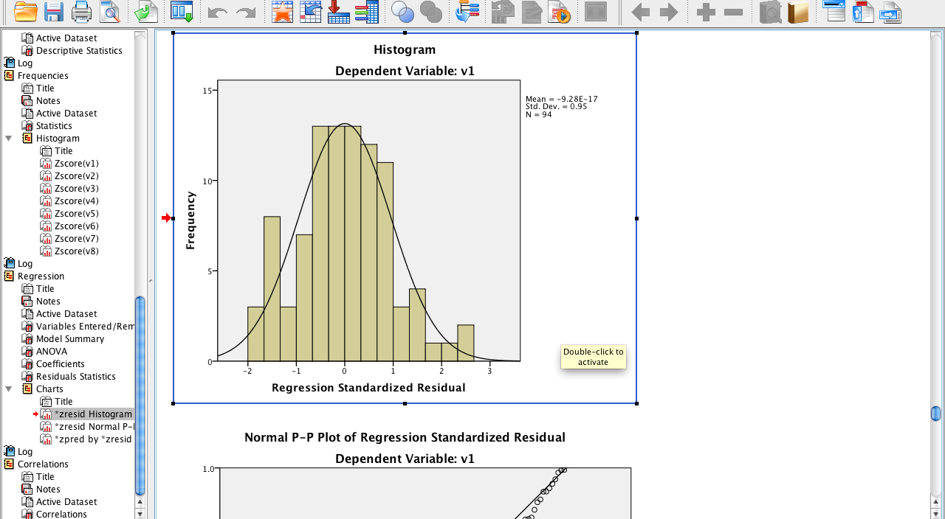

Slide 79
Homogeneity
Assumption that the variances of the variables are roughly equal.
Ways to check – you do NOT want p < .001:
Levene’s - Univariate
Box’s – Multivariate
You can also check a residual plot (this will give you both uni/multivariate)

Slide 80
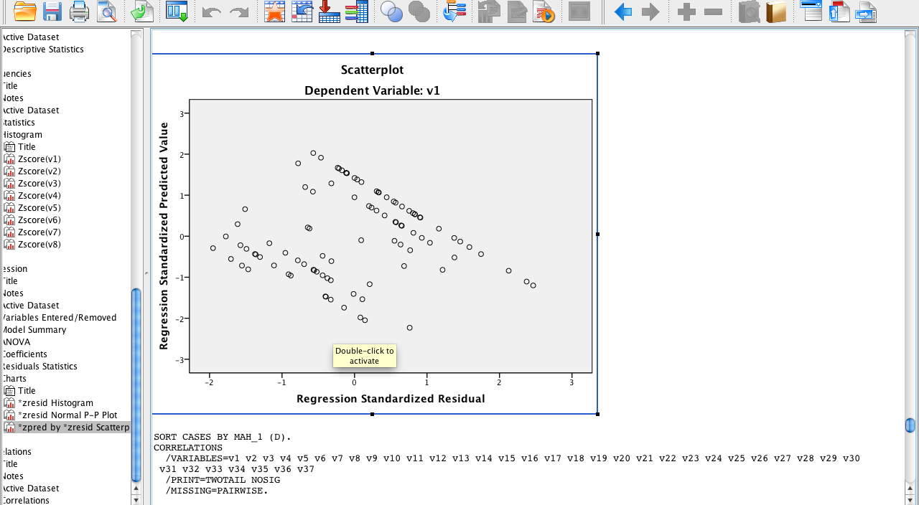

Slide 81
Homogeneity
Spherecity – the assumption that the time measurements in repeated measures have approximately the same variance
Difficult assumption…

Slide 82
Assessing Homogeneity of Variance

Slide 83
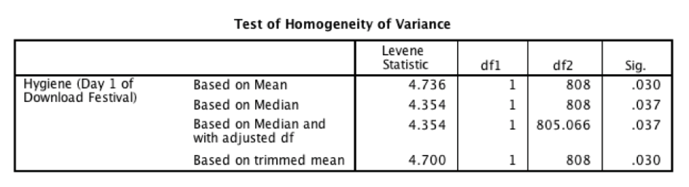
Output for Levene’s Test

Slide 84
Homoscedasticity
Spread of the variance of a variable is the same across all values of the other variable
Can’t look like a snake ate something or megaphones.
Best way to check is by looking at scatterplots.

Slide 86
Homoscedasticity/ Homogeneity of Variance
Can affect the two main things that we might do when we fit models to data:
Parameters
Null Hypothesis significance testing

Slide 87
Spotting problems with Linearity or Homoscedasticity

Slide 88
Homogeneity of Variance

Slide 89
Independence
The errors in your model should not be related to each other.
If this assumption is violated:
Confidence intervals and significance tests will be invalid.
You should apply the techniques covered in Chapter 20.

Slide 90
Transforming Data
Log Transformation (log(X_{i}))
Reduce positive skew.
Square Root Transformation (√X_{i}):
Also reduces positive skew. Can also be useful for stabilizing variance.
Reciprocal Transformation (1/ X_{i}):
Dividing 1 by each score also reduces the impact of large scores. This transformation reverses the scores, you can avoid this by reversing the scores before the transformation, 1/(X_{Highest} – X_{i}).

Slide 91
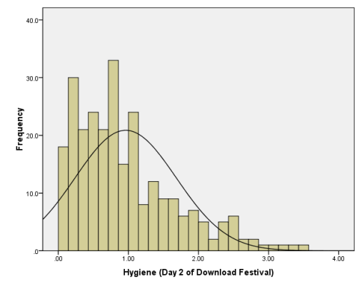
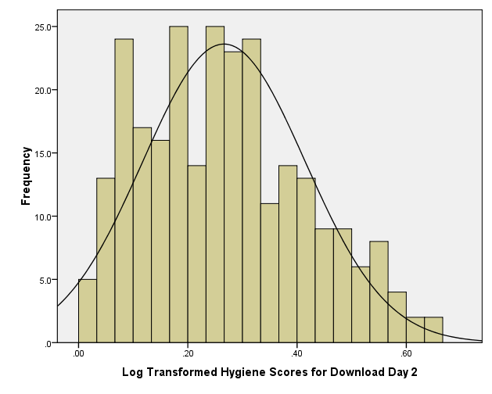
Log Transformation
Before
After

Slide 92
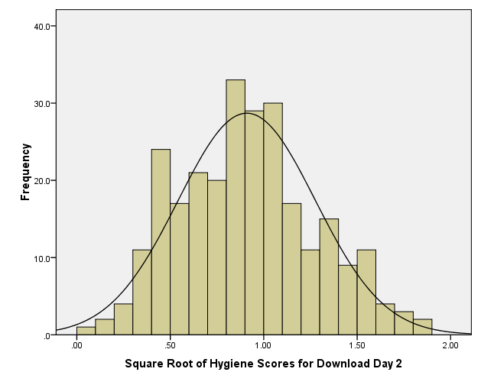
Square Root Transformation
Before
After

Slide 93
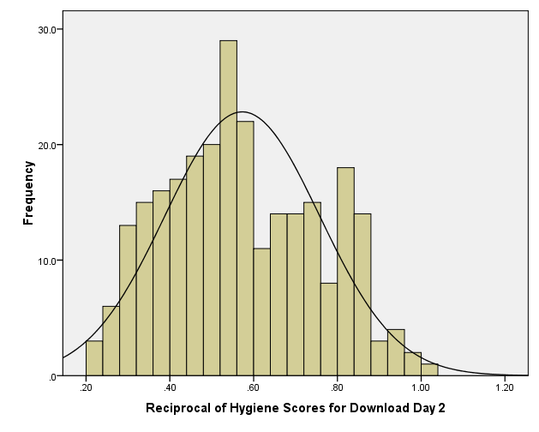
Reciprocal Transformation
Before
After

Slide 94
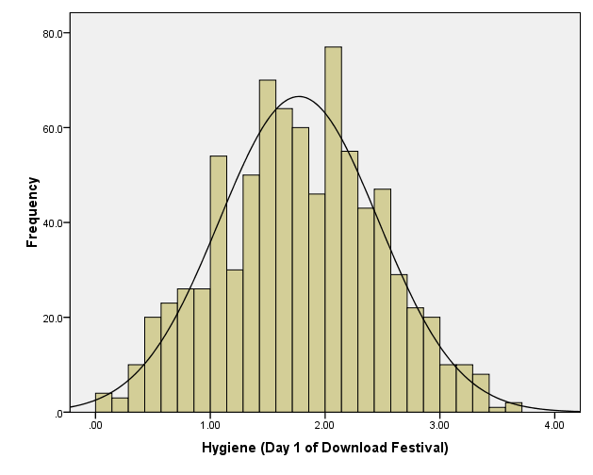
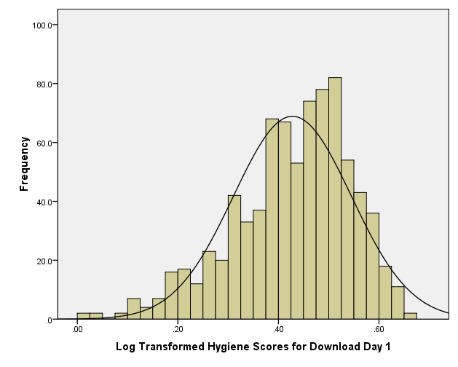
But …
Before
After

Slide 95

To Transform … Or Not
Transforming the data helps as often as it hinders the accuracy of F (Games & Lucas, 1966).
Games (1984):
The central limit theorem: sampling distribution will be normal in samples > 40 anyway.
Transforming the data changes the hypothesis being tested
E.g. when using a log transformation and comparing means you change from comparing arithmetic means to comparing geometric means
In small samples it is tricky to determine normality one way or another.
The consequences for the statistical model of applying the ‘wrong’ transformation could be worse than the consequences of analysing the untransformed scores.

Slide 96
SPSS Compute Function
Be sure you understand how to:
Create an average score mean(var,var,var)
Create a random variable
I like rv.chisq, but rv.normal works too
Create a sum score sum(var,var,var)
Square root sqrt(var)
Etc (page 207).

